Slide 1


Homework11
JS Practices

Slide 2
Before you start!!!
Create
Please make sure that you have a folder called as “homework”
Create
Please create a file called as “homework11.js” inside the homework folder
Do
Do all tasks in the same file
Follow
Please follow the instructions carefully and understand requirements before starting coding
Let
Let TechGlobal Team if any of requirement is not clear or you have any questions related to given tasks below

Slide 3
Task-1
Requirement:
Write a function named countPalindrome() which takes a string and returns the number of palindrome words.
Note: A palindrome word is a word that reads the same forwards and backwards. Example: level, radar, deed, refer.
Examples:
countPalindrome("Mom and Dad"​) -> 2
countPalindrome("See you at noon") -> 1
countPalindrome("Kayak races attracts racecar drivers") -> 2
countPalindrome("") -> 0
countPalindrome("No palindrome here") -> 0

Slide 4
Task-2
Requirement:
Write a function named sum() which takes an array of numbers and a boolean value as arguments. It will return the sum of the numbers positioned at even indexes if true. And, return sum of numbers positioned at odd indexes if false.
Examples:
sum([1, 5, 10], true) -> 11
sum([3, 7, 2, 5, 10], false) -> 12
sum([-1, 1, -2, 2], true) -> -3
sum([0, -1, 15, 1], false) -> 0
sum([1, 2, 3, 4, -4], true) -> 0

Slide 5
Task-3
Requirement:
Write a function named nthChars() which takes a string and a number as arguments and returns the string back with every nth characters.​
Examples:
nthChars("Java", 2) -> "aa"
nthChars("JavaScript", 5)​ -> "St"
nthChars("Java", 3)​ -> "v"
nthChars("Hi", 4)​ -> ""
nthChars("0123456789", 2) -> "13579"

Slide 6
Task-4
Requirement:
Write a function named canFormString() which takes two string arguments and returns true if the second string can be formed by rearranging the characters of first string. Return false otherwise.
NOTE: This method is case-insensitive and ignore the white spaces.
Examples:
canFormString("Hello", "Hi")​ -> false
canFormString("programming", "gaming")​ -> true
canFormString("halogen", "hello")​ -> false
canFormString("CONVERSATION", "voices rant on")​ -> true
canFormString("12", "123") -> false

Slide 7
Task-5
Requirement:
Write a function named isAnagram() which takes two string arguments and returns true if the given strings are anagram. Return false otherwise.
NOTE: An anagram is a word or phrase formed by rearranging the letters of another word or phrase. In the context of strings, checking if two strings are anagrams of each other means verifying if they contain the same characters in the same quantities, regardless of the order of those characters.
NOTE: This method is case-insensitive and ignore the white spaces.
Examples:
isAnagram("Apple", "Peach")​ -> false
isAnagram("listen", "silent")​ -> true
isAnagram("astronomer", "moon starer")​ -> true
isAnagram("CINEMA", "iceman")​ -> true
isAnagram("123", "1234") -> false

Slide 8
Task-6
Requirement:
Write a function named count() which takes an array of numbers and a boolean value as arguments. It will return the total count of the even numbers if the boolean value is true. And return the total count of the odd numbers if the boolean value is false.
Examples:
count([1, 5, 10], true) -> 1
count([3, 7, 2, 5, 10], false) -> 3
count([-1, 1, -2, 2], true) -> 2
count([0, -1, 15, 1], false) -> 3
count([1, 2, 3, 4, -4], true) -> 3

Slide 9
Task-7
Requirement:
Write a function named sumDigitsDouble() which takes a string and returns the sum of the digits in the given String multiplied by 2. Return -1 if the given string does not have any digits. Ignore negative numbers.
Examples:
sumDigitsDouble("Javascript") -> -1
sumDigitsDouble("23abc45")​ -> 28
sumDigitsDouble("Hi-23") -> 10
sumDigitsDouble("ab12") -> 6
sumDigitsDouble("n0numh3r3") -> 12

Slide 10
Task-8
Requirement:
Write a function named countOccurrence() which takes two string arguments and returns how many times that the first string can form the second string.
Examples:
countOccurrence("Javascript", "Java") -> 1
countOccurrence("Hello", "World") -> 0
countOccurrence("Can I can a can", "anc")​ -> 3
countOccurrence("Hello", "l")​ -> 2
countOccurrence("IT conversations", "IT")​ -> 2

Slide 11
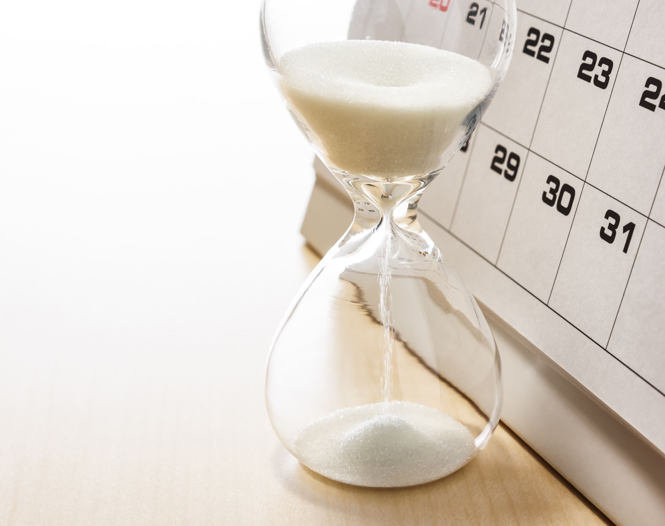
DUE DATE
10/30/2024 04:00 PM CST
Homework needs to be submitted to Bilal on Slack in private

